Slide 1

Dine-N-Dash
“Get In, Get Out”
Notes:
Introduction

Slide 2
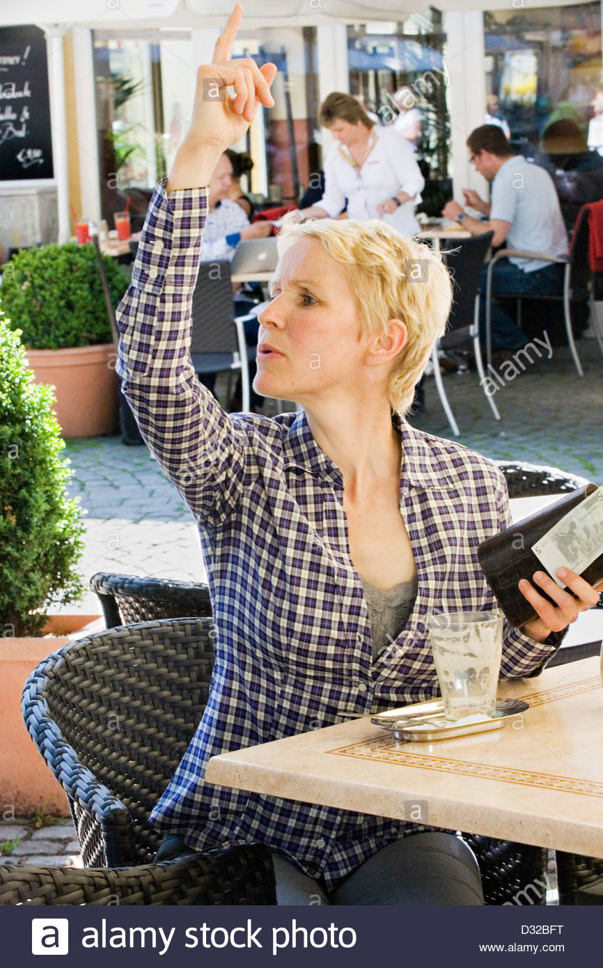
Stuck waiting for the check?
Notes:
The problem
Our company develops mobile applications that patrons use to pay their bill. This results in a big increase in efficiency for the restaurants check-out portion which ultimately decreases the wait time and helps restaurants generate more revenue by being able to serve more customers. We use a novel approach because unlike most other developers, we visit each restaurant to find out exactly what people need. Although this takes a bit more time, it means that on average, 95 percent of our clients are happy with the first beta version of their app.

Slide 3
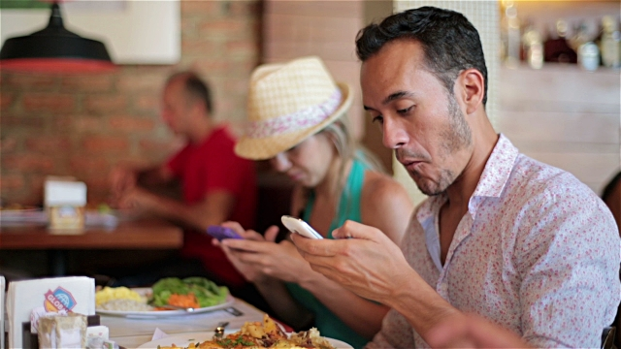
Pay through your mobile device
Notes:
The solution

Slide 4
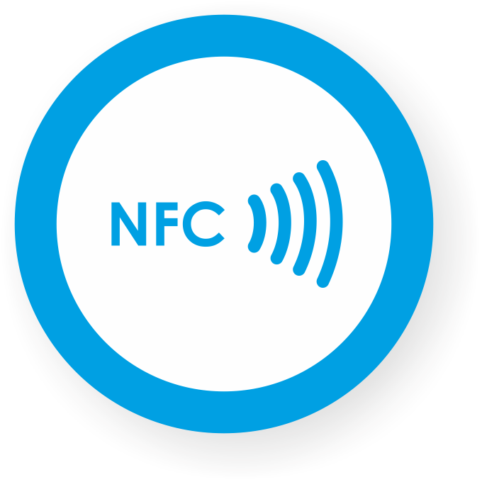
Mobile App
For Patrons
Web App
For Restaurants
NFC And
QR-Codes
At The Table
Notes:
The Plan:
The way we are implementing our idea is by building a mobile app for the patrons, web app for restaurants, and nfc chips for the tables at the restaurant.

Slide 5
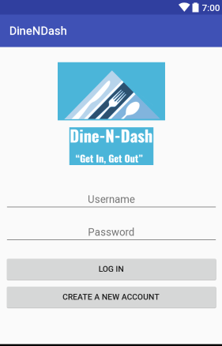
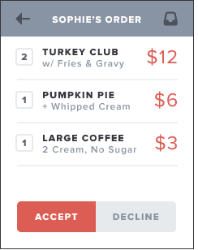
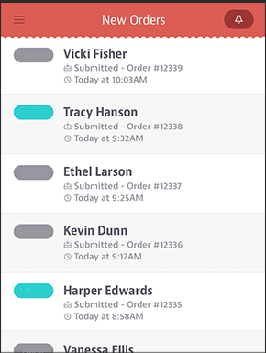
Notes:
Mockup – Wireframe
The way the process works is: when the patrons go to the restaurant all they have to do is log in to dine n dash, tap their phone on the nfc chip, and then they will be synced in with the restaurant’s system. The waiter takes the order from the patron and puts in the order in their web app which the patrons can review on their mobile devices in real time. Once they are done eating all they have to do is tap the accept button and they will be good to go.

Slide 6
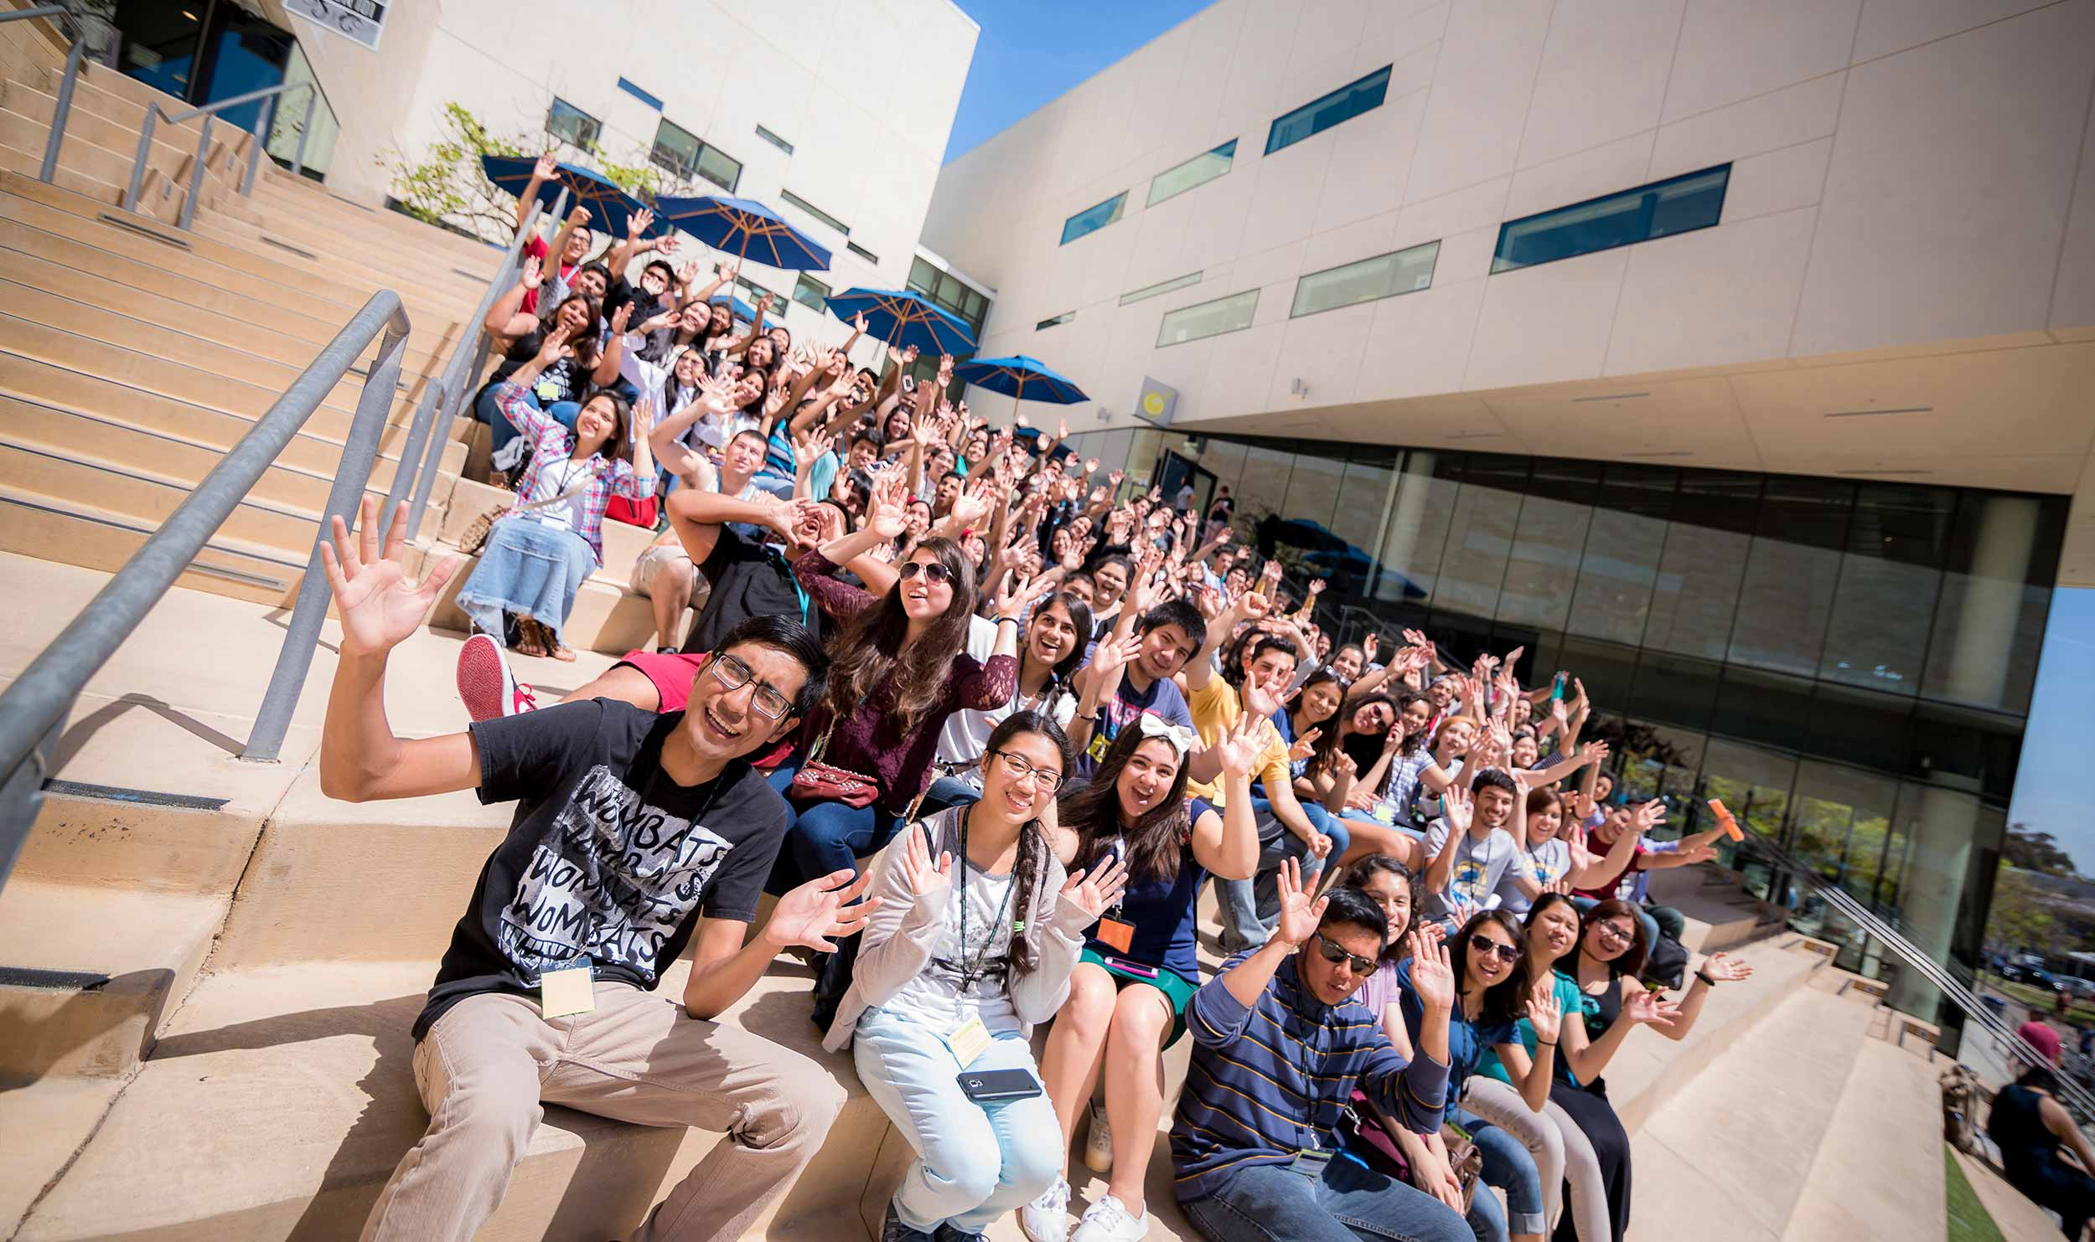




600,000
20,565,890
100%
That’s a lot of restaurants
And that’s a lot of college students
Total success!
Notes:
Market size
Restaurants are sit down with an internet connection

Slide 7
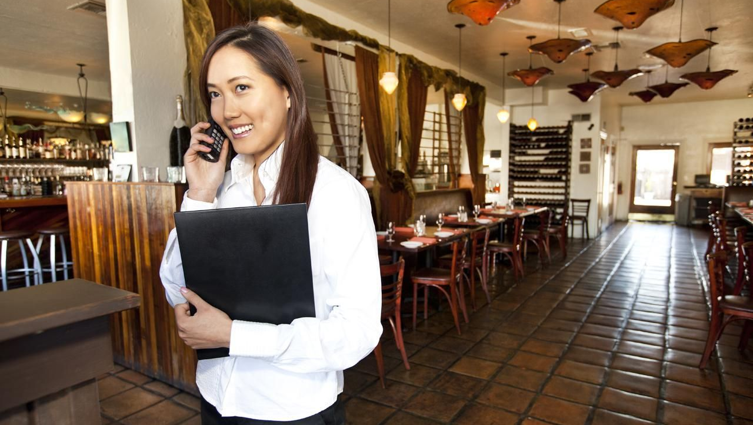
Restaurant managers
57.5% of restaurant managers agree this will increase efficiency
Notes:
Customer feedback
Restaurant managers say this app will increase inefficiency - less wait time for bill, more customers served, more $$

Slide 8
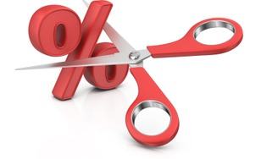
Targeting high-volume restaurants, we will take a % cut from each transaction.
Notes:
Business Model
For our revenue stream, we plan on targeting high-volume restaurants and taking a percentage cut from each transaction that occurs. If we consider that 58% of people in the U.S. go out to eat at least once a week, based off of 10,000 installs of our application and taking a 3.5% cut from each transaction, we expect to generate about $150,000 in revenue in a year. This number may increase depending on the number of users who use our application, how often they go out to eat, and how large their bill is.
# of installs * 0.58 * (0.01*15) * 4 * 12
58% of people go out to eat at least once a week.
Average bill at restaurant is $15.
Average of eating out 4 times a month.

Slide 9
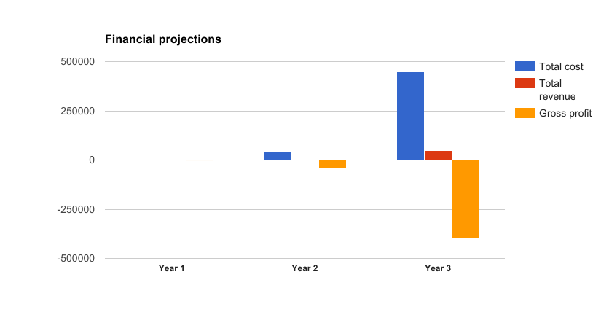
Notes:
Finance slide
Based on our financial projections, as you can see from our first two years, we expect to make no profits. This is because we will be in the development phase of our applications. By our third year, we will have our full release of our applications and we expect to generate $150,000 in revenue.

Slide 10
 | Split Bill | Mobile Payment | Pay Simultaneously
Splitwise | ✔
Amazon Go |  | ✔
Ziosk | ✔ | ✔
Dine-N-Dash | ✔ | ✔ | ✔
Notes:
Competition
The competition to our product are Splitwise, Amazon Go, and Ziosk. Based off the chart above we can see that both Splitwise and Ziosk have a similar feature to our app in which we are all able to split the bill. However for Splitwise, they are unable to do mobile payments whereas Ziosk and Dine-N-Dash are. Now going against Ziosk, they only utilize one device which means that patrons must take turns paying, whereas our app utilizes their mobile devices so they can all pay simultaneously. We also view Amazon Go as a competitor because they have the same idea of speeding up the payment process and they might expand into restaurants. However they require restructuring the whole building for their technology to work where Dine-N-Dash just uses mobiel devices and the restaurants computer.

Slide 11

Stickers
Word of Mouth / Social Media
Pay to get featured in App Store
Notes:
Marketing Plan
As far as marketing, we will be utilizing stickers. They are cheap and easy items to hand out. We will rely on social media and word of mouth, targeting students at local colleges in San Diego. We can also pay to get featured in the App Store.

Slide 12
THANKS!
Dine-N-Dash, faster than cash
Any questions?

